Slide 1

ETEC-303 Digital Communication Lecture - 2
Instructor:
Abhishek Gagneja
Digital Communication Slides

Slide 2
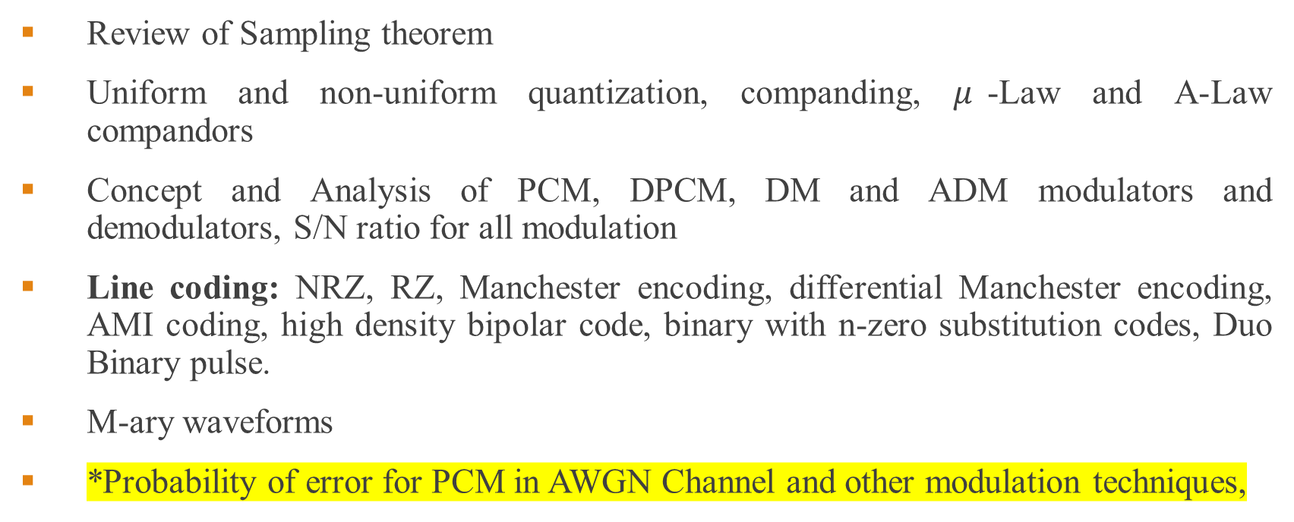
Unit 1 – Introduction to Digital Communication
Review of Sampling theorem
Uniform and non-uniform quantization, companding, $μ$-Law and A-Law compandors
Concept and Analysis of PCM, DPCM, DM and ADM modulators and demodulators, S/N ratio for all modulation
Line coding: NRZ, RZ, Manchester encoding, differential Manchester encoding, AMI coding, high density bipolar code, binary with n-zero substitution codes, Duo Binary pulse.
M-ary waveforms
*Probability of error for PCM in AWGN Channel and other modulation techniques,
24 July 2020
Digital Communication Slides

Slide 3
Sampling
24 July 2020
Digital Communication Slides

Slide 4
Effect of increasing the sampling time period
24 July 2020
Digital Communication Slides

Slide 5
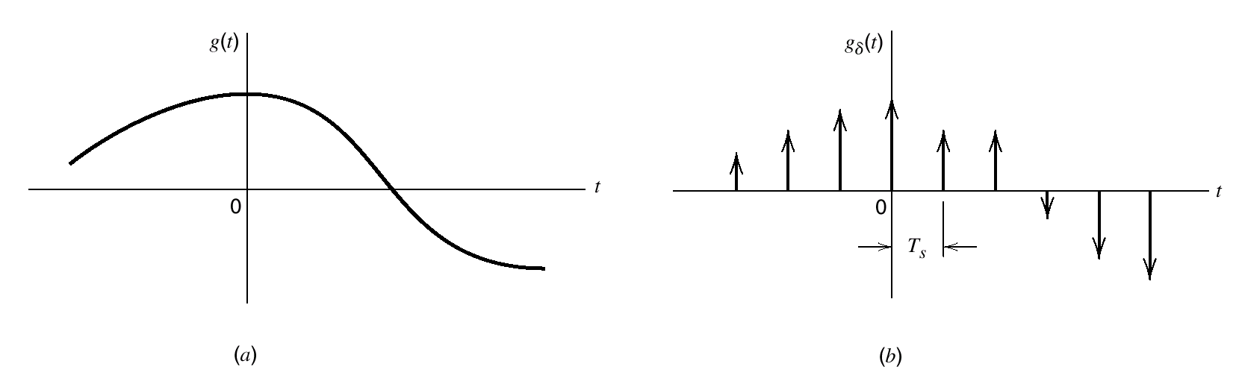
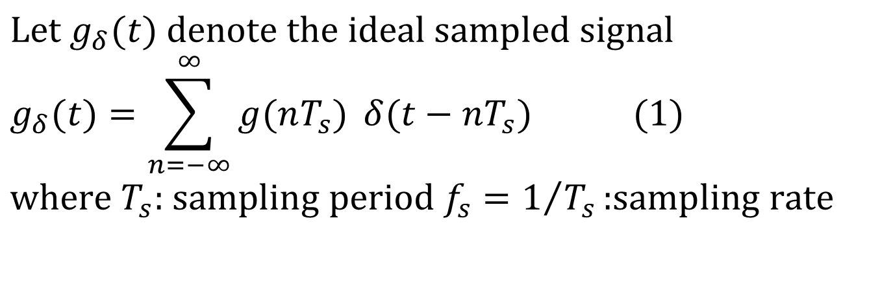
Sampling Process (maths)
$$\text{Let} g_{δ}(t) \text{denote} \text{the} \text{ideal} \text{sampled} \text{signal} \\ g_{δ}(t)=\sum_{n=−∞}^{∞}{g(nT_{s}) }δ(t−nT_{s}) (1) \\ \text{where} T_{s}\text{: }\text{sampling} \text{period} f_{s}=1/{T_{s}}\text{:}\text{sampling} \text{rate}$$
24 July 2020
Digital Communication Slides

Slide 6
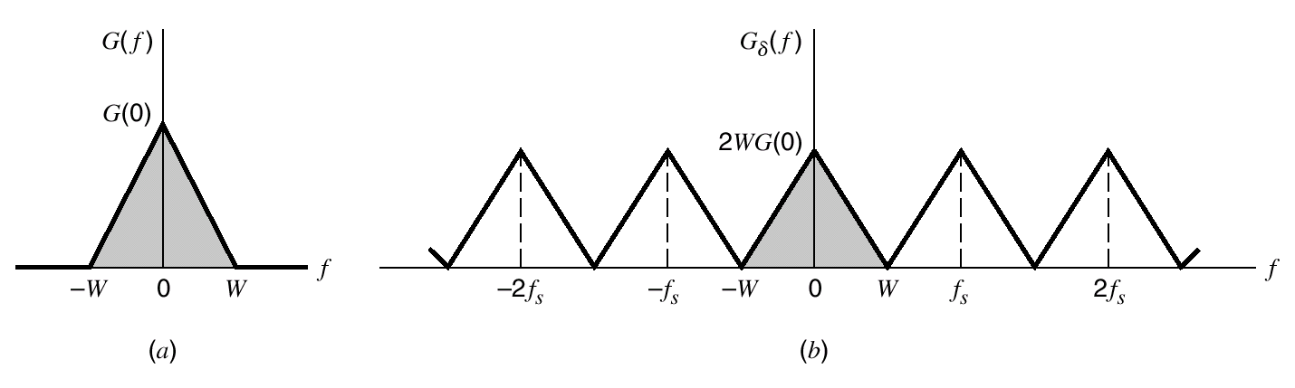

Sampling Process (maths)
Using Fourier Transform we can write: $$g(t)\sum_{n=−∞}^{∞}{δ(t−nT_{s})}⇔G(f)∗\frac{1}{T_{s}}\sum_{m=−∞}^{∞}{δ\left(f−\frac{m}{T_{s}}\right)} \\ =\sum_{m=−∞}^{∞}{f_{s}G(f−mf_{s})} \\ g_{δ}(t)⇔f_{s}\sum_{m=−∞}^{∞}{G(f−mf_{s})} (2)$$
$$\text{or} \text{we} \text{may} \text{apply} \text{Fourier} \text{Transform} \text{on} (1) \text{to} \text{obtain} \\ G_{δ}(f)=\sum_{n=−∞}^{∞}{g(nT_{s})}\exp{(}−j2π nf T_{s}) (3) \\ \text{or} G_{δ}(f)=f_{s}G(f)+f_{s}\sum_{\begin{aligned}&m=−∞ \\ & m≠0\end{aligned}}^{∞}{G(f−mf_{s}) (4)} \\ \text{If} G\left(f\right)=0 \text{for} \left|f\right|≥W \text{and} T_{s}=1/{2W} ⇒ G_{δ}(f)=\sum_{n=−∞}^{∞}{g\left(\frac{n}{2W}\right)\exp\left(−\frac{jπ n f}{W}\right) (5)}$$
24 July 2020
Digital Communication Slides

Slide 7
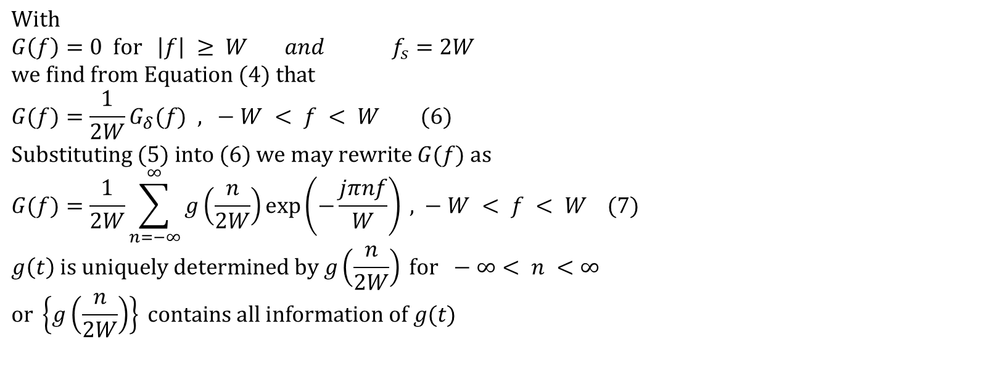
Math, cont.
$$\text{With} \\ G\left(f\right)=0 \text{for} \left|f\right| ≥ W and f_{s}=2W \\ \text{we} \text{find} \text{from} \text{Equation} (4) \text{that} \\ G(f)=\frac{1}{2W}G_{δ}(f)\text{ , }−W < f < W (6) \\ \text{Substituting} (5) \text{into} (6) \text{we} \text{may} \text{rewrite} G(f) \text{as} \\ G(f)=\frac{1}{2W}\sum_{n=−∞}^{∞}{g\left(\frac{n}{2W}\right)\exp\left(−\frac{jπnf}{W}\right)}\text{ , }−W < f < W (7) \\ g\left(t\right) \text{is} \text{uniquely} \text{determined} \text{by} g\left(\frac{n}{2W}\right) \text{for} −∞< n <∞ \\ \text{or} \left\{g\left(\frac{n}{2W}\right)\right\} \text{contains} \text{all} \text{information} \text{of} g(t)$$
24 July 2020
Digital Communication Slides

Slide 8
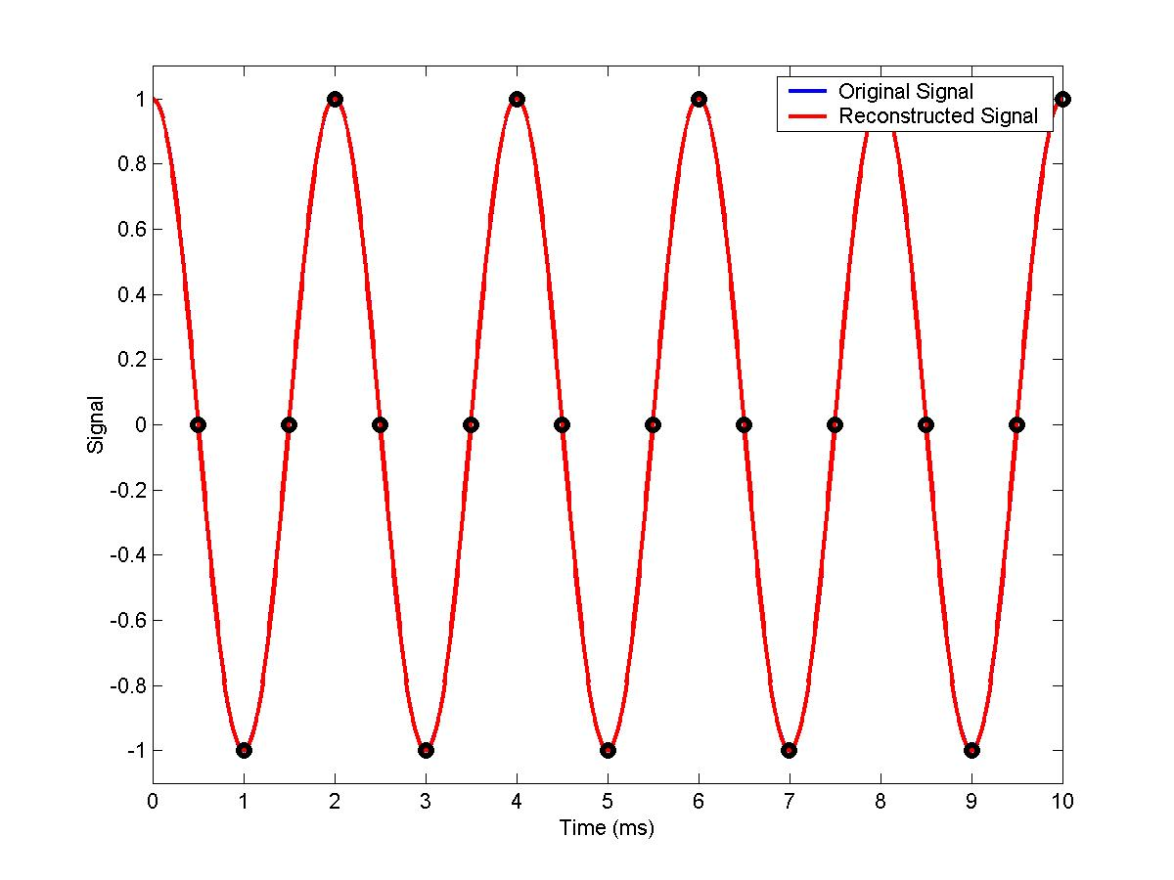
Example: Aliasing of Sinusoidal Signals
Frequency of signals = 500 Hz, Sampling frequency = 2000Hz
24 July 2020
Digital Communication Slides

Slide 9
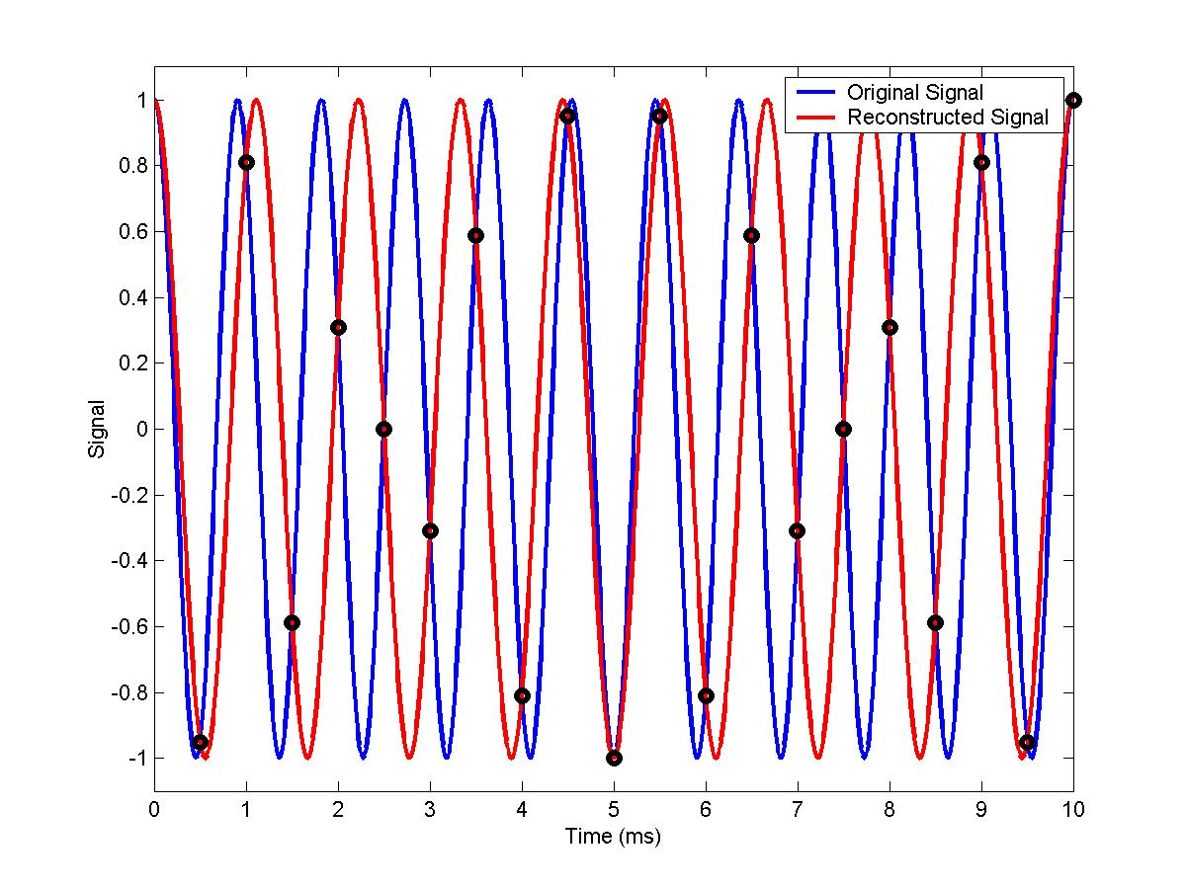
Example: Aliasing of Sinusoidal Signals
Frequency of signals = 1100 Hz, Sampling frequency = 2000Hz
24 July 2020
Digital Communication Slides

Slide 10
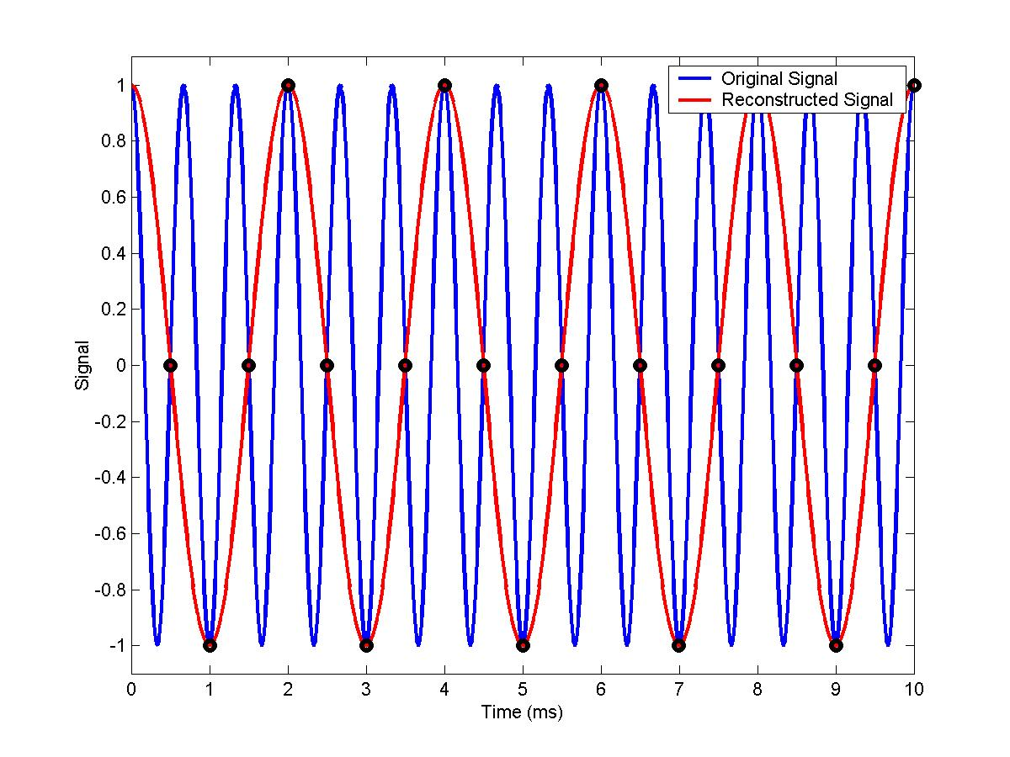
Example: Aliasing of Sinusoidal Signals
Frequency of signals = 1500 Hz, Sampling frequency = 2000Hz
24 July 2020
Digital Communication Slides

Slide 11
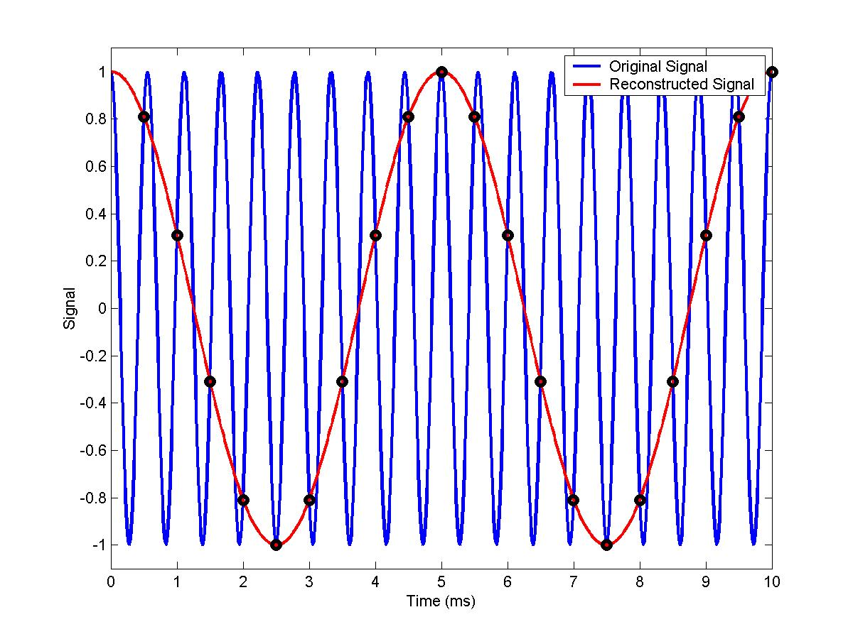
Example: Aliasing of Sinusoidal Signals
Frequency of signals = 1800 Hz, Sampling frequency = 2000Hz
24 July 2020
Digital Communication Slides

Slide 12
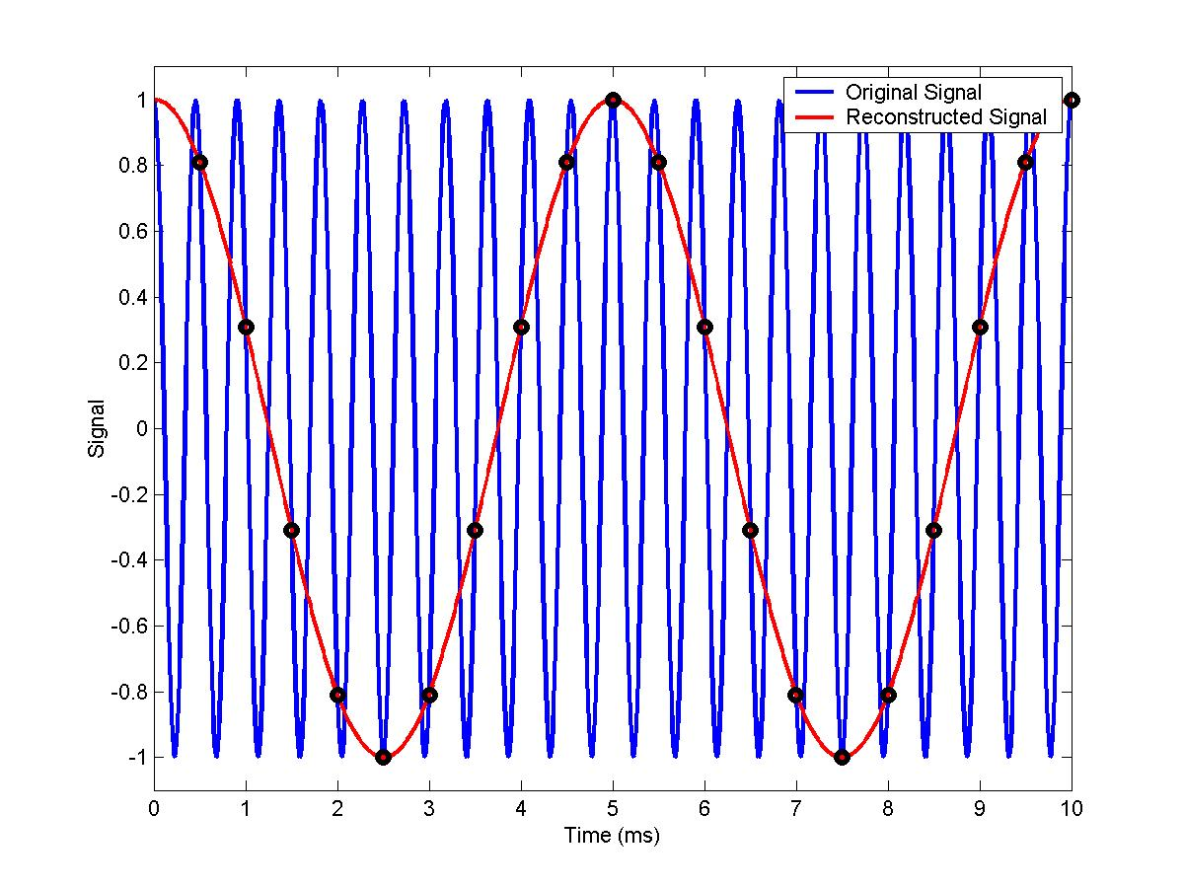
Example: Aliasing of Sinusoidal Signals
Frequency of signals = 2200 Hz, Sampling frequency = 2000Hz
24 July 2020
Digital Communication Slides

